Slide 1

Complaint Care A Complaint Management System With AI Chatbot Integration & Transformer-based Architecture For Ticket Management System
NAME | REG NO
GANIPINENI BHARDWAJ NAIDU | 99220040844
BYREDDY RAMI REDDY | 99220040816
GUVVALA HARSHAVARDHAN REDDY | 99220040858
KADAPANA VENKATA SIVA MAHIDHAR REDDY | 99220040868
Guided by :Dr .T. ManiKumar

Slide 2
Abstract
Complaint Care is designed to provide a streamlined and intelligent framework for grievance redressal. It enables users to register complaints, track their status in real time, and receive timely updates, while administrators manage and resolve issues through a structured ticketing system. With an integrated AI chatbot, the platform enhances user interaction by offering instant assistance, while a transformer-based model ensures accurate categorization and prioritization of complaints. This reduces workload, improves accountability, and accelerates resolution, delivering a transparent, efficient, and user-friendly complaint management solution.

Slide 3
Project Overview
Provides a centralized platform for complaint registration and tracking.
Replaces manual processes with a structured ticket management system.
Integrates an AI chatbot for instant user assistance.
Uses transformer-based models for automatic categorization and prioritization.
Ensures real-time status updates for users.
Enables administrators to efficiently manage and resolve complaints.
Delivers transparency, faster resolution, and improved accountability.

Slide 4
Problem Statement
Traditional complaint management systems in organizations and institutions often face inefficiencies due to manual categorization, prioritization, and resolution of complaints, which leads to delays, unresolved issues, and lack of transparency. Existing systems lack intelligent features such as automated ticket classification, real-time prioritization, multilingual support, and chatbot assistance, resulting in poor user satisfaction and ineffective grievance redressal. Therefore, there is a need for an AI-powered complaint management system that leverages NLP and machine learning to automate categorization, assign priority, provide real-time updates, and improve overall efficiency, scalability, and transparency in handling complaints.

Slide 5
Literature Review
S.No | Title | Author(s) | Publisher/Journal | Year | Remarks
1. | AI-Driven Complaint Classification in Smart Cities | R. Mehta, S. Kulkarni | IEEE Smart City Innovations | 2021 | Focuses on automating complaint categorization using AI. Limitation: lacks real-time query resolution. Our system overcomes this with an AI chatbot.
2. | Web-Based Grievance Redressal Systems: A Case Study | P. Sharma, L. Verma | Springer Advances in Computing | 2020 | Explores digital grievance portals but highlights poor user engagement and limited scalability. Our project resolves this by integrating real-time database (Firebase) and modern UI.

Slide 6
S.No | Title | Author(s) | Publisher/Journal | Year | Remarks
3 | NLP Applications in Complaint Management | T. Gupta, M. Rao | ACM Transactions on Information Systems | 2019 | Applies NLP to analyze complaint text but lacks prioritization of issues. Our model prioritizes queries by urgency.
4 | Cloud-Based Complaint Portals for Universities | A. Iqbal, K. Thomas | Elsevier Journal of Cloud Computing | 2022 | Discusses cloud integration but notes high maintenance costs. Our approach ensures cost-effectiveness with Firebase.
5 | Data Analytics for Public Feedback Systems | J. Singh, R. Patel | IEEE Big Data Conference | 2018 | Uses analytics to detect trends but does not provide instant responses. Our chatbot handles real-time responses.

Slide 7
S.No | Title | Author(s) | Publisher/Journal | Year | Remarks
6 | Machine Learning for Automated Query Resolution | N. Kumar, S. Banerjee | Wiley Expert Systems | 2021 | Implements ML in query resolution but fails in multi-domain classification. Our model categorizes into academic, technical, and maintenance queries.
7 | Enhancing University Portals with AI Chatbots | L. Fernandez, P. Wong | Springer Education Technology | 2020 | Focuses on chatbots for FAQs only, lacking deep integration with databases. Our chatbot integrates real-time data for personalized query resolution.
8 | Real-Time Feedback and Grievance Redressal Systems | R. Mehta, S. Kulkarni | IEEE Transactions on Services | 2019 | Provides feedback analysis but does not offer query prioritization. Our system prioritizes complaints by urgency and category for efficient redressal.

Slide 8
S.No | Title | Author(s) | Publisher/Journal | Year | Remarks
9 | Scalable Cloud Architectures for Student Complaint Data | H. Zhang, Y. Lee | Elsevier Journal of Cloud Systems | 2021 | Focuses on scalability but lacks security considerations. Our project incorporates JWT authentication and role-based access for better security.
10 | Automated Support Systems using Hybrid AI Models | P. Das, G. Nair | ACM Computing Surveys | 2023 | Proposes hybrid AI but with limited real-world validation. Our system is implemented and validated in a real university complaint environment.

Slide 9
Drawbacks of Existing
Lack of Prioritization: Many systems fail to classify issues by urgency, leading to delays in resolving critical complaints.
Delayed Response Times: Traditional feedback and complaint systems rely on manual processing, causing long turnaround times.
No Real-Time Assistance: Most systems lack AI chatbots or real-time support, forcing users to wait for human intervention.
Low User Satisfaction: Due to delays, unclear tracking, and limited transparency, students and staff often feel their issues remain unresolved.
Manual Complaint Raising: Manual complaint raising is time-consuming, error-prone, and lacks transparency in tracking and resolution.
Weak Classification Accuracy: Current ML-based systems often fail in multi-domain classification
Absence of Dashboard in Admin Login: The admin login does not provide a dashboard, leading to inefficient complaint monitoring and management.

Slide 10
Advantages of Proposed System
Efficient Prioritization: Our system uses transformer-based models to categorize and prioritize complaints by urgency, ensuring critical issues are resolved first.
Faster Response Times: AI-driven ticket automation minimizes manual intervention, significantly reducing turnaround time for complaint resolution.
Real-Time Assistance: An integrated AI chatbot provides instant support, guiding users through complaint registration and offering immediate responses.
Enhanced User Satisfaction: Transparent tracking, timely updates, and structured resolution workflows improve trust and overall user experience.
Automated Complaint Raising: Users can submit complaints digitally with guided assistance, eliminating manual effort and reducing errors.
High Classification Accuracy: Advanced NLP models ensure accurate categorization across multiple domains (academic, technical, and maintenance).
Interactive Admin Dashboard: A comprehensive dashboard for admins enables effective monitoring,complaint tracking, and data-driven decision-making.

Slide 11
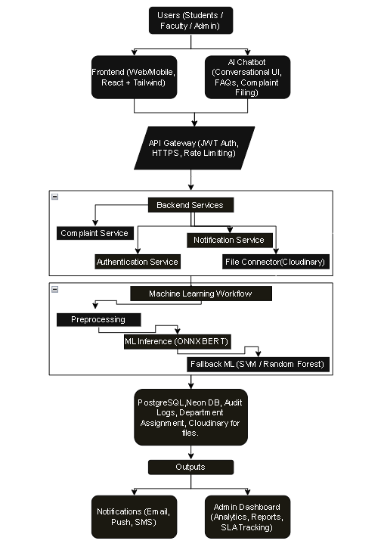
Proposed Methodology

Slide 12
Technical Stack
Frontend
Core: React 18.2.0, JavaScript (ES6+), Vite 7.0.4
Styling & UI: Tailwind CSS 3.4.17, Headless UI 2.0.0, Uncertainty
Visualization: Chart.js 4.4.0, react-chartjs-2 5.2.0
Backend
Core: Python 3.8+, Flask 2.3.3, Flask-CORS 4.0.0
Database: PostgreSQL (via Neon URI)
AI/ML: BERT, Pre-trained Classifiers (.pkl)
APIs & Services: Gemini API, Cloudinary 1.36.0, Flask-Mail 0.9.1, requests 2.31.0

Slide 13
Technical Stack
Infrastructure & Deployment
Containerization: Docker, Docker Compose
Cloud Services: Vercel (Frontend), Neon (DB), Cloudinary (Media)
Version Control: Git, GitHub

Slide 14
Modules
User Authentication & Authorization
Secure signup/login with JWT
Role-based access (Student, Faculty, Admin)
Complaint Management
Complaint submission with category & priority
Ticket ID generation & tracking
Status updates (Pending, In Progress, Resolved, Closed)
AI/ML Module
Automatic categorization of complaints (Technical, Academic, Hostel/Mess, Maintenance)
Priority detection (Low, Medium, High, Urgent)
Smart routing to relevant admin
Admin Dashboard
Centralized complaint monitoring
View, update, and respond to complaints
Analytics & reports (charts/graphs)

Slide 15
Modules
5. Chatbot Support (Gemini API)
AI-powered virtual assistant
Real-time guidance for complaint submission and queries
6. Notification System
Email alerts for complaint updates
Admin notifications for new complaints
7. File & Media Management
Cloudinary integration for uploading evidence (images/documents)
Secure cloud-based storage
8. Report & Analytics Module
PDF generation of complaint reports (ReportLab)
Data visualization (Chart.js)
Performance tracking & insights

Slide 16

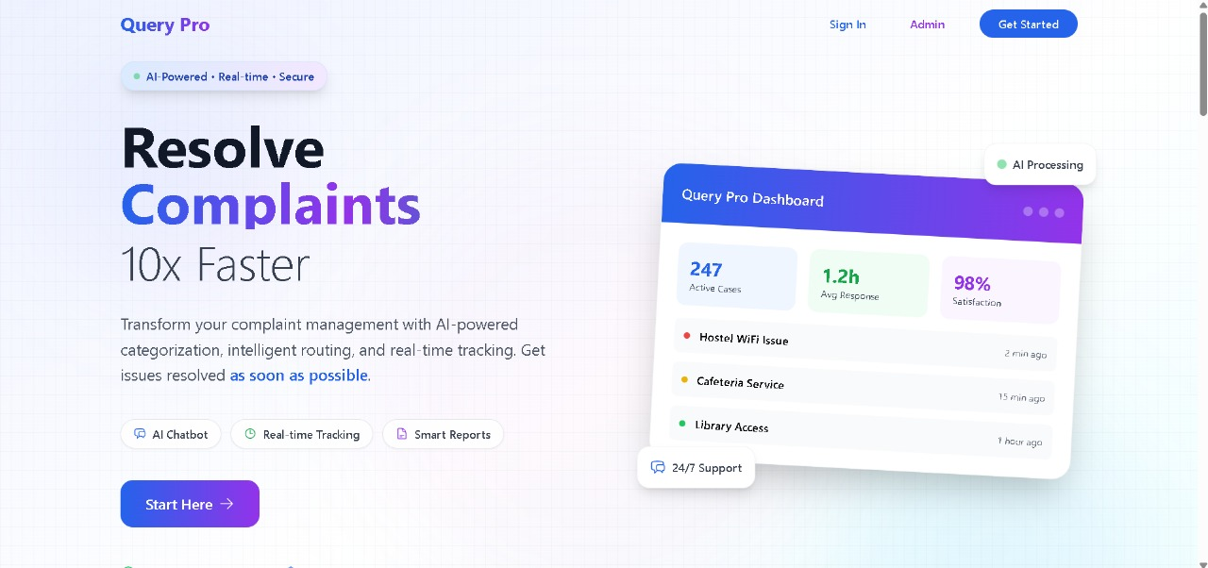
Implementation
The implementation of Complaint Care demonstrated significant improvements in both processing efficiency and user experience compared to conventional complaint management systems. The integration of a transformer-based architecture allowed the system to achieve higher accuracy in complaint categorization and priority detection, while the fallback machine learning models ensured uninterrupted service reliability.

Slide 17
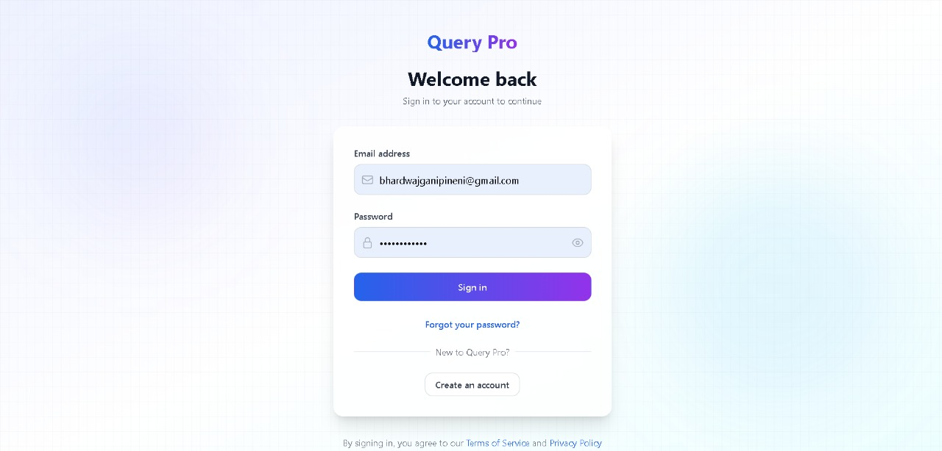

Slide 18
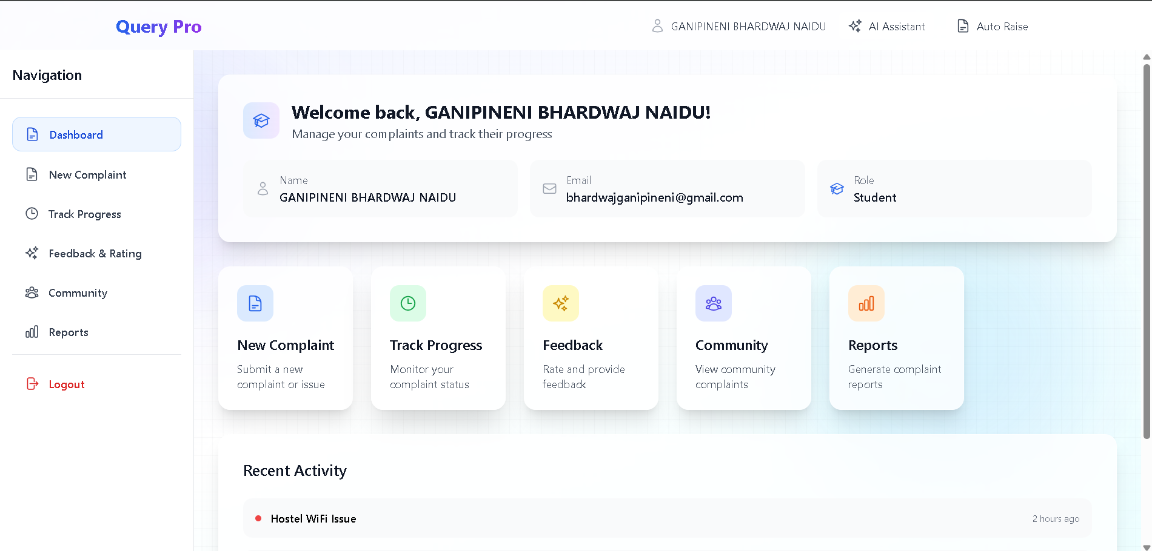

Slide 19
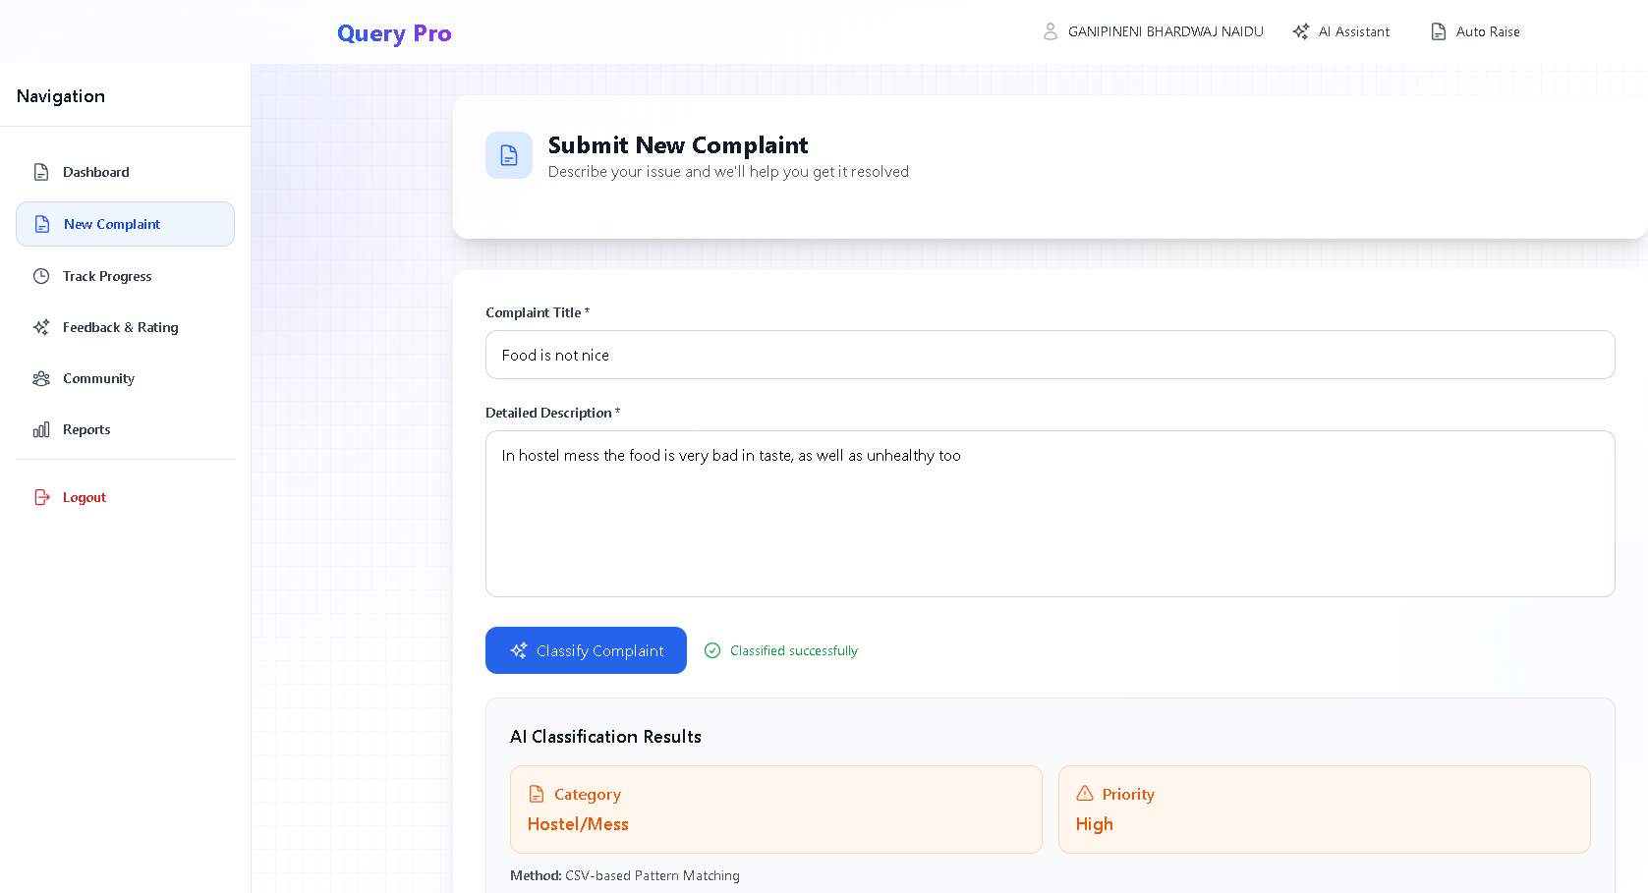

Slide 20
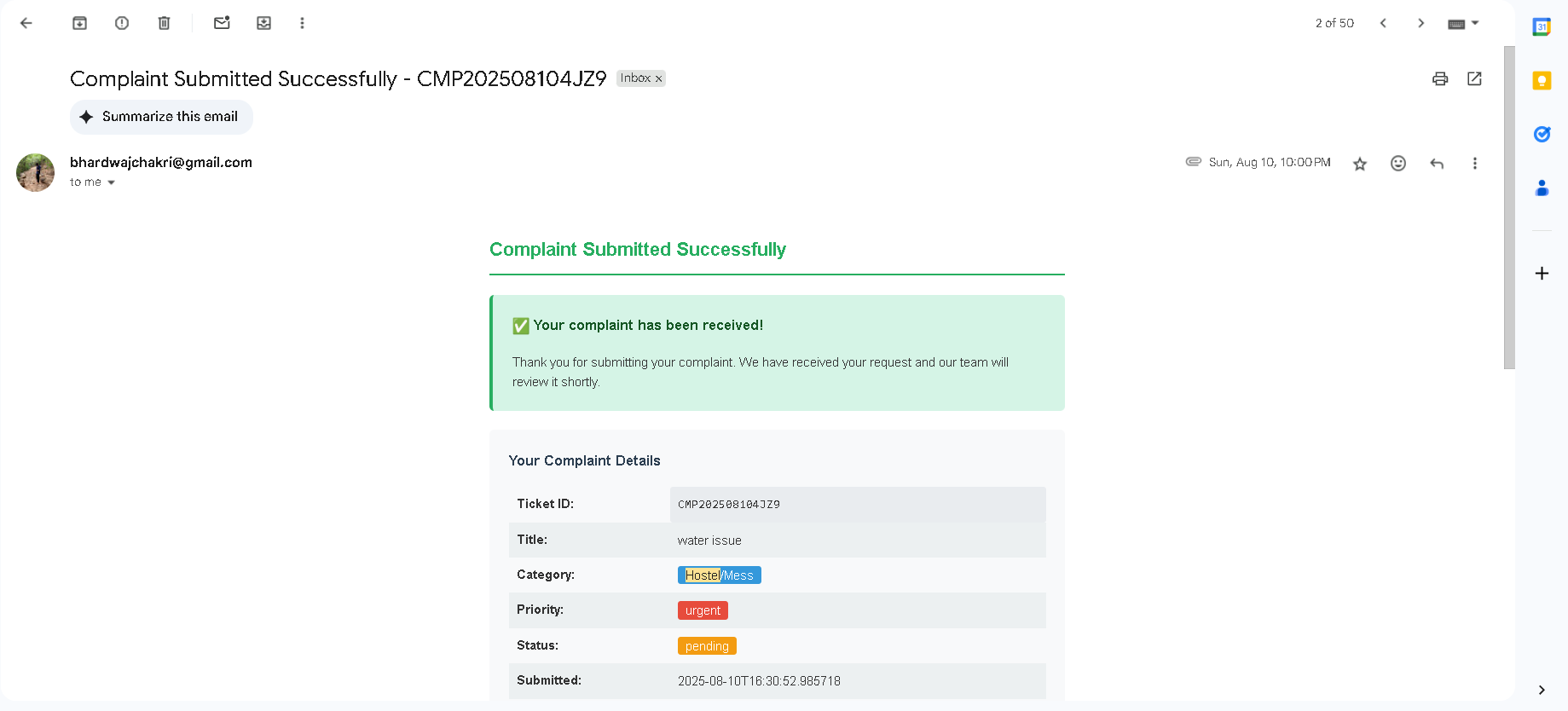

Slide 21
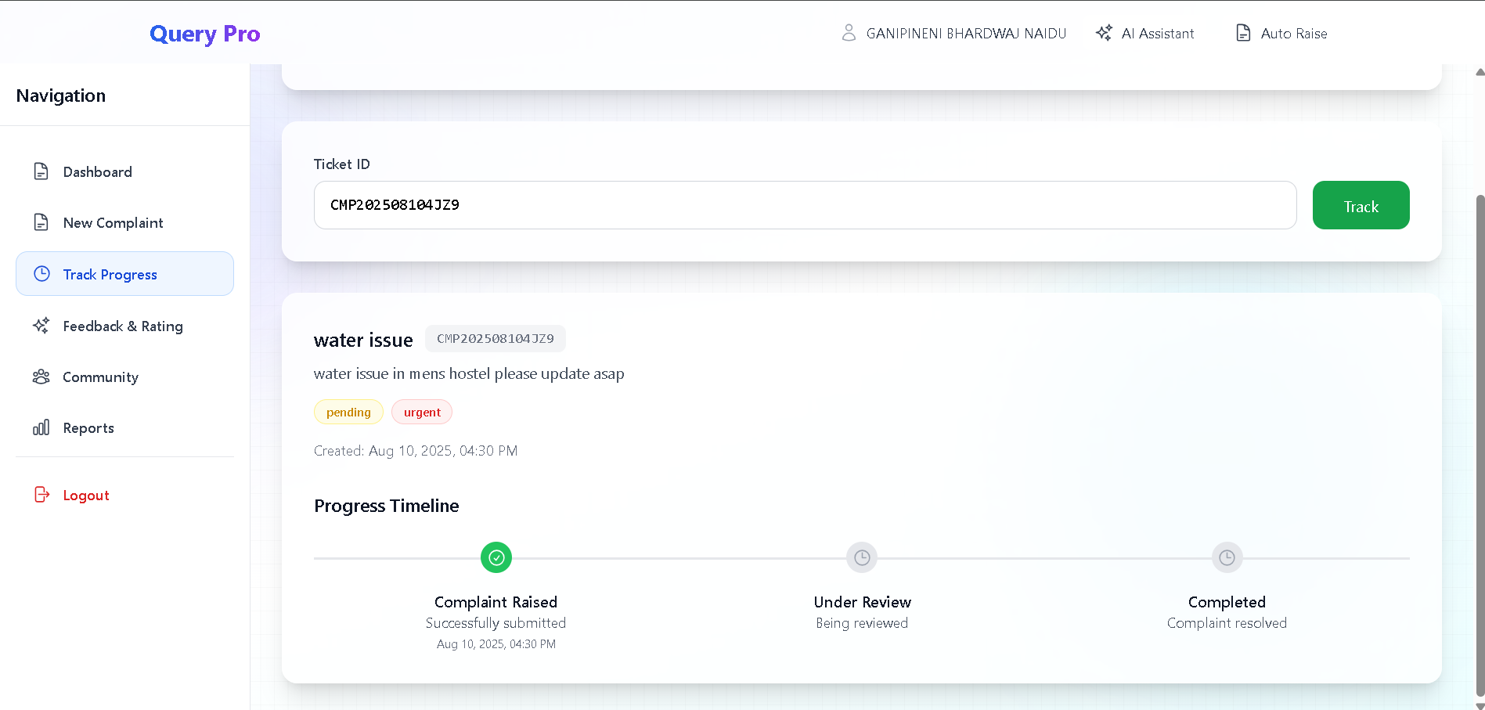

Slide 22
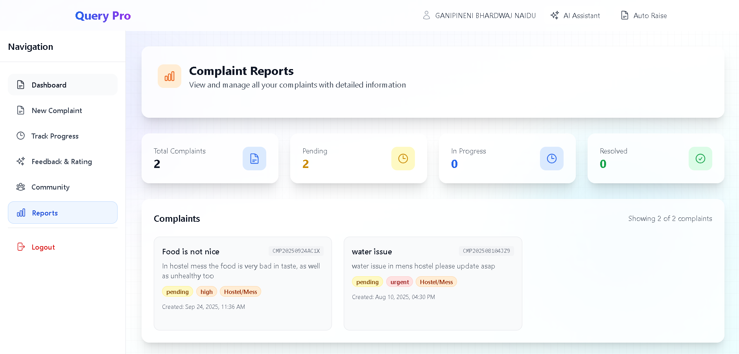

Slide 23
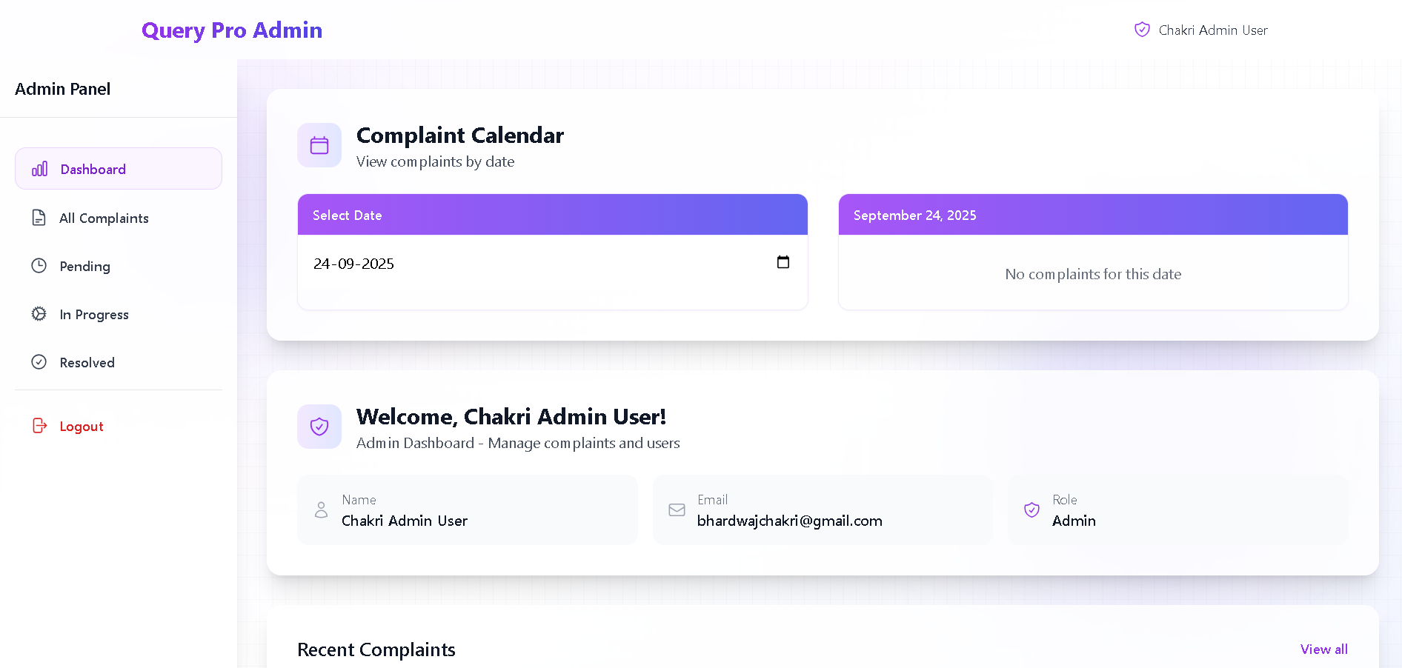

Slide 24
Publications:
Dr.T.Manikumar,Ganipineni Bhardwaj Naidu,Byreddy Rami Reddy,Guvvala Harshavardhan Reddy,Kadapana Venkata Siva Mahidhar Reddy “Complaint Care - A Complaint Management System With AI Chatbot Integration & Transformer-based Architecture For Ticket Management System” submitted a paper in International Conference on Intelligent Systems, Smart and Green Technologies (ICISSGT - 2025)

Slide 25
Conclusion:
Complaint Care, an AI-powered complaint management system that uses transformer-based models to automate complaint classification, priority detection, and routing, was introduced in this paper. High accuracy and low latency were attained by the system, which was backed by fallback machine learning for continuous dependability. Complaint Care improved resolution times, decreased manual labor, and increased transparency for all parties involved when compared to traditional systems. Administrators profited from dashboards and automated routing, while user studies validated its user-friendly interface, speedy submission process, and efficient real-time tracking.In conclusion, Complaint Care offers an intelligent and scalable way to handle institutional grievances. Future research will focus on cross-lingual

Slide 26
References:
[1].H. M. Mohamed, A. H. Mohamed, S. O. Hashi, H. N. Hassan, K. A. Barre, and B. A. Ahmed, “Automated university complaint management system by leveraging machine learning and natural language processing for enhanced efficiency and accuracy,” Forum for Linguistic Studies, vol. 7, no. 2, pp. 1–12, 2025.
[2].H. Pang and C. Li, “A BERT and TextCNN integration-based method for public complaints and proposals text classification,” in Proc. ACM Conf., 2025, pp. 1–6, doi:10.1145/3704814.3704819.
[3].T. Manikumar and A. J. S. Kumar, “A buffered genetic algorithm for automated branch coverage in software testing,” Journal of Information Science and Engineering, vol. 35, no. 2, pp. 245–273, 2019.
[4].T. Manikumar, A. J. S. Kumar, and R. Maruthamuthu, “Automated test data generation for branch testing using incremental genetic algorithm,” Sādhanā, vol. 41, no. 9, pp. 959–976, 2016.
[5].T. Manikumar, G. Natarajan, and R. Gnanasekaran, “Multidisciplinary Applications of Machine Learning,” in Machine Learning, Blockchain and Cyber Security in Smart Environments, pp. 41–57, 2022.
[6].T. Manikumar, R. R. Subramanian, K. Venkatesh, R. R. Sudharsan, and V. Aravindrajan, “SHAPE: Design and Evaluation of a Transformative Model for Engineering Education,” Journal of Engineering Education Transformations, vol. 38, Special Issue 1, pp. 153–158, 2024.
[7].T. Manikumar, R. R. Subramanian, K. Venkatesh, and A. B. Mohideen, “Enhancing Software Engineering Education through Project-Based Learning,” Journal of Engineering Education Transformations, vol. 38, Special Issue 1, pp. 173–178, 2024.
[8].K. Arutselvan, P. N. Palanisamy, M. Sugumaran, and T. Manikumar, “Enhancing PV System Efficiency: An Analysis of Intelligent MPPT Algorithms,” Nanotechnology Perceptions, vol. 21, no. 1, pp. 79–89, 2025.

Slide 27
THANK YOU

